Slide 1
A Conversation with Young Zoroastrian Professionals
Fall 2020 Webinars
On Preparing to Leave Home (Parents and Children)
Social and Cultural Changes
Panelists
Karishma Koka
Nazneen Mistry
Vehzan Rustomji
Synthesizer
Zenhar Marolia
Moderator
Farrokh Mistree
farrokh.mistree@ou.edu
Entrepreneurship is the pursuit of opportunity beyond resources controlled

Slide 2
Forthcoming Conversations
December 20, 2020. 7:30PM India Time. 7:00PM Pakistan Time.
Scholarships and funding for graduate education: Requirements + Timeline
Panelists – Farrokh Rustomji + TBD
January 17, 2021. 7:30PM India Time. 7:00PM Pakistan Time.
Getting most of College Experience + Building your network + Selling yourself
Panelists - Farzin Avari + Zenhar Marolia + Nazneen Mistry
Notes:
Farrokh to fix later.

Slide 3
Plan for Conversation on November 15, 2020
1. Opening: What this webinar is about. 5 Minutes.
2. Panelist Introductions: 2 minutes each. Total 6 minutes.
Commentary – Academic journey to issues of interest for participants. 5 minutes each. Total 15 minutes.
Synthesis and Questions for Clarification – Moderated. Total 20 minutes.
5. Dialog – Moderated to foster dialog between panelists and participants / what would participants like to hear next? Total 45 minutes
6. Closing Remarks: ZFN official + Panelists + Moderator. Total 10 minutes.
Opening
Panelists
Commentary
Clarification
Dialog
Closing Remarks

Slide 4
What We Are About?
The World Zoroastrian Chamber of Commerce (WZCC) in partnership with Zarathushti faculty in academia envision empowering Zarathushti students to learn how to create economic, cultural and intellectual value.
ZFN MISSION: Facilitate Zoroastrian youth, through higher and specialized education, to pursue careers in industry, government, and academia as business entrepreneurs, social entrepreneurs and knowledge entrepreneurs.
ZFN Webinars: Conversations to help Zoroastrain youth with support of their parents to attain higher and specialized education.
This initiative is supported by R.D. Sethna Scholarship Funds. https://www.rdsethnascholarships.org/ For further information contact rdsethnascholarship@gmail.com
Opening
Panelists
Commentary
Clarification
Dialog
Closing Remarks
Notes:
Farrokh: ZFN role. Not to do work for you.

Slide 5
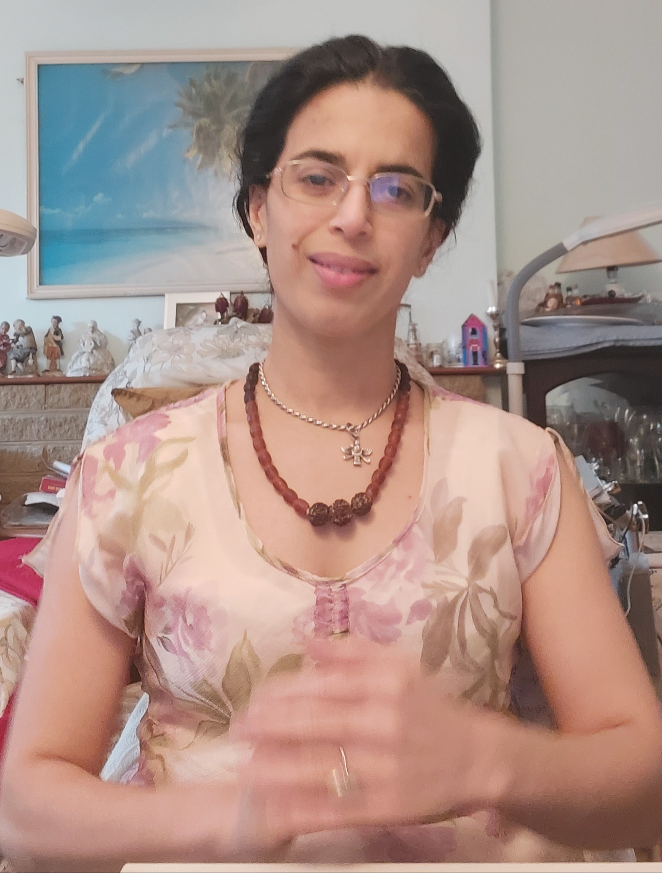
Karishma Koka
Location: London, UK
Background: PhD Neurosciences (Univ. of Cambridge), MSc (Research) (Tata Institute for Fundamental Research) Computational Neuroscience, (Bangalore), BSc Environmental Science, Chemistry, Biology.
Position: Learning and Development Consultant - Strategic Meta-cognitive Solutions for Academics, Corporate Executives.
Co-founder Ultimate Achievements Academy
Passion: Empowering Individuals through Education.
Bringing people together for the greater good of all.
Contact
dr.kokakavitakarishma@cantab.net
https://www.linkedin.com/in/koka-kavita-karishma-phd-university-of-cambridge-ba82a6103/?originalSubdomain=uk
Opening
Panelists
Commentary
Clarification
Dialog
Closing Remarks

Slide 6
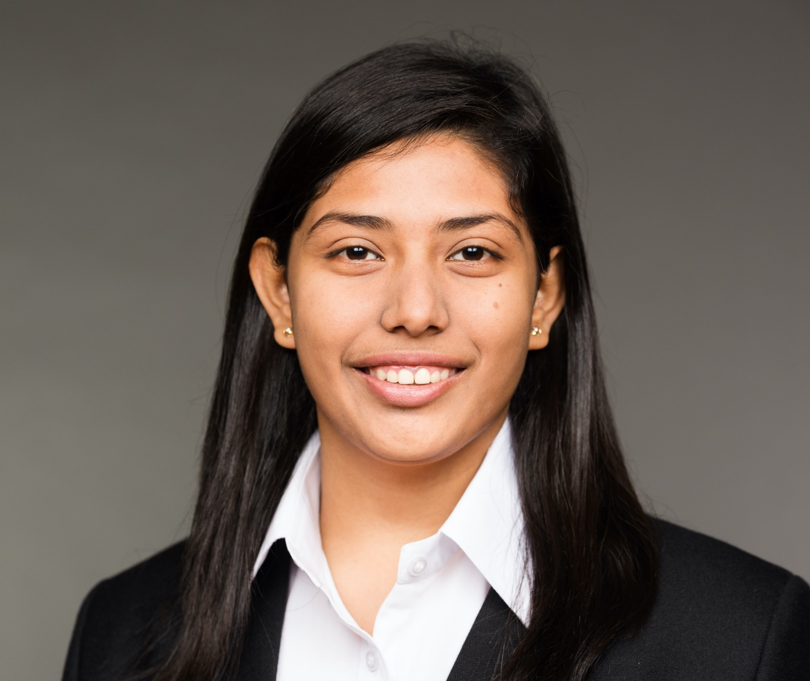
Nazneen S. Mistry
Location: New Brunswick, New Jersey, USA
Background: BCom and MCom Part 1 from University of Mumbai, India. Master of Financial Analysis from Rutgers The State University of New Jersey
Position: Looking for positions in the finance field
Passion: To assist the youth to achieve their goals
Contact
nazneen.mistry97@gmail.com
https://www.linkedin.com/in/nazneenmistry/
Opening
Panelists
Commentary
Clarification
Dialog
Closing Remarks

Slide 7
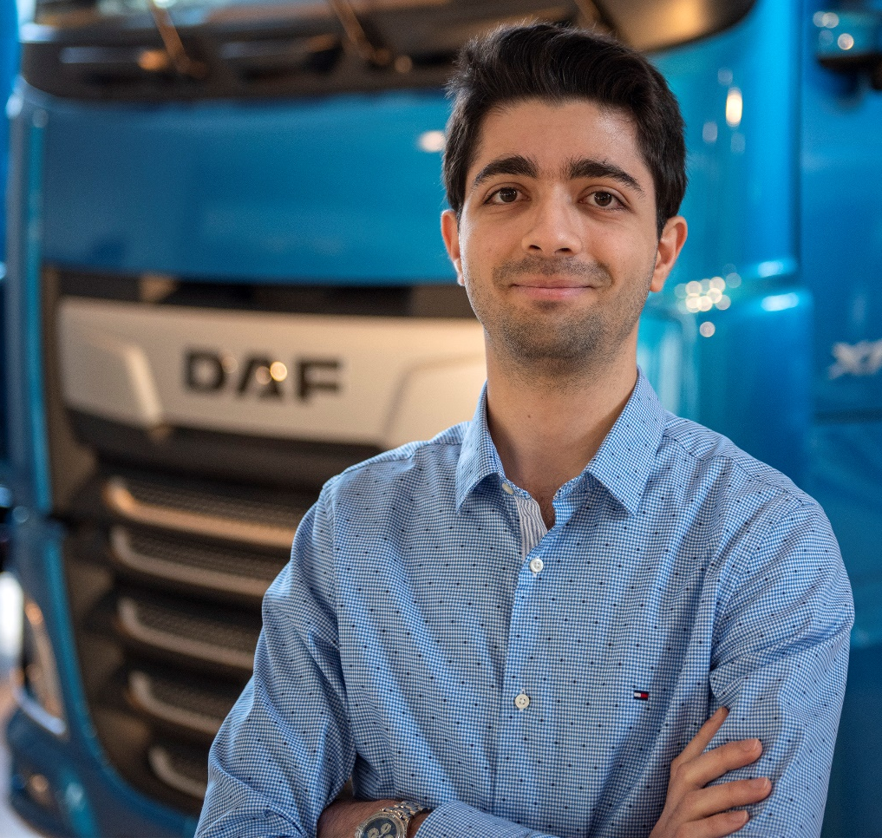
Vehzan Rustomji
Location: Eindhoven, Netherlands
Background: Born in New Delhi, brought up in Mumbai. B.Tech. in Mechatronics at Manipal Institute of Technology, India. M.Sc. in Automotive Technology at TU Eindhoven, Netherlands.
Position: System Calibration Engineer (Engine Development) at DAF Trucks.
Passion: To enable the next generation to take better decisions.
Contact
vehzan.rustomji@gmail.com
https://www.linkedin.com/in/vehzan/
Opening
Panelists
Commentary
Clarification
Dialog
Closing Remarks

Slide 8
Karishma Koka. From Choices to Action.
1. Academic Journey
Parents made sacrifices + empowered me to
make choices - listening + team-work
Perfect preparation promotes proper performance. Set goals, take action, outcomes emerge
Preparation to be away from home – enjoying processes – housekeeping, health, self-learning
2. Lessons from Academic Journey (UK)
Choice of course, University / College-based Uni
study culture: group/CBL/PBL/EBL/systems-based
Regularity - read, revise, research
Balanced joyful discipline: reduces stress + achieves targets
You are your first start-up – build competencies, soft-skills, evaluate risks, EQ/IQ, take criticism, build teams
3. Happy in Your New Home (Social values-your values)
Learning to enjoy being prepared for change
Extracurricular: with others + on your own
Utilise University resources with balance
Appreciating all cultures/peoples
Expressing choice with respect appropriately learning to say no to smoking, late nights, drugs
4. Tips for Parents and Young Zoroastrians (Team)
Discuss options/the right action, difficulties-> opportunities
Timely dialogue, building trust + self-regulation
Belong to a Zoroastrian organisation
ZTFE in London - young person grows within the community
Strength from wisdom in our Doctrine – to evolve solutions →Create order+happiness (Ushta) - home is where you are.
Opening
Panelists
Commentary
Clarification
Dialog
Closing Remarks
Notes:
A complex system is a system composed of interconnected parts that as a whole exhibit one or more properties (behavior among the possible properties) not obvious from the properties of the individual parts.
A system’s complexity may be of one of two forms: disorganized complexity and organized complexity.^{[2]} In essence, disorganized complexity is a matter of a very large number of parts, and organized complexity is a matter of the subject system (quite possibly with only a limited number of parts) exhibiting emergent properties.

Slide 9
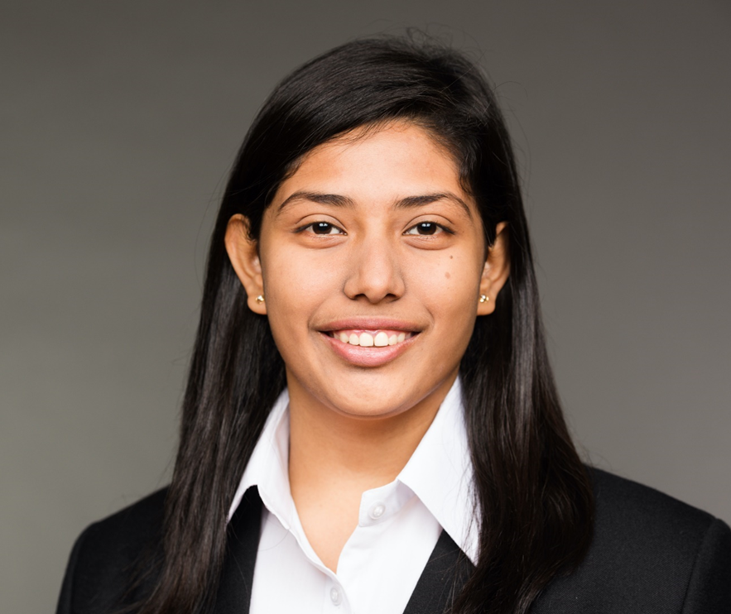
Nazneen S. Mistry. Adapting To New Lifestyle.
1. Academic Journey
Belong to a family where education and career hold high values
My parents have been major pillars to my success
My passion for finance
My motivation to do my graduate degree was to build a good career base and excel in it
My influencers are my parents, professors and peers
2. Lessons from Academic Journey (US)
Exposure to online technology
Lots of projects work
Heavy course load
Recommend to pursue a two-year program
3. On Being Happy in Your New Home
Join different organizations of your university through social media
Experience of living by yourself and adjusting with new roommates
Doing all the household chores
4. Tips for Parents and Young Zoroastrians
In context of being happy at your new home …
Adjusting to new eating habits
Socializing with people of other cultures
Adjusting to the new lifestyle
Emotional acceptance
Opening
Panelists
Commentary
Clarification
Dialog
Closing Remarks
Notes:
A complex system is a system composed of interconnected parts that as a whole exhibit one or more properties (behavior among the possible properties) not obvious from the properties of the individual parts.
A system’s complexity may be of one of two forms: disorganized complexity and organized complexity.^{[2]} In essence, disorganized complexity is a matter of a very large number of parts, and organized complexity is a matter of the subject system (quite possibly with only a limited number of parts) exhibiting emergent properties.

Slide 10
Vehzan Rustomji. Leave Home + Social + Cultural.
1. Academic Journey
Key focus: Application based engineering
Parents: Support in my chosen academic direction. Prompt for PhD.
Chose automotive as it is my passion.
Motivation to get a graduate degree: Hunger was not satiated with just a bachelor degree.
Influencers: Parents, Uncle, Ratan Tata, Frank Willems.
2. Lessons from Academic Journey (NL)
Cultural change: Interaction with professors. Closed vs open door policy.
Zoroastrianism: Maintain morals and ethics in work.
Knowing what you do NOT want is as important.
M.Sc. extended beyond the expected time.
4. Tips for Parents and Young Zoroastrians
Pack smartly: Know what you can leave out.
Aggressive budgeting. Stay on top of your personal expenses.
Learn quick recipes for nutritious food. Don’t survive on fast food!
Share thoughts and experiences regularly with your parents.
3. On Being Happy at Your New Home
Check for local Zoroastrian organizations and families.
Support group: Friends.
Weather: Winters and mental health.
Opening
Panelists
Commentary
Clarification
Dialog
Closing Remarks
Notes:
My notes:
Q1:
Q2:
Self study sessions
Q3:
Find out before hand what the emergency public services number is.
Register with Indian embassy.
Fixing housing and accommodation before hand.
Eindhoven fam are like my Godparents.
Q4:
Check for student baggage allowances with the airline.
Must have: Pressure cooker, a spare Kusti!
Check for Indian stores in the area from seniors.
Winter clothes, food items, utensils.
Take your time to chose your social circle.
For next webinar (doesn’t seem to fit here):
Post grad life: Higher salaries in USA vs better work life balance in EU.
A complex system is a system composed of interconnected parts that as a whole exhibit one or more properties (behavior among the possible properties) not obvious from the properties of the individual parts.
A system’s complexity may be of one of two forms: disorganized complexity and organized complexity.^{[2]} In essence, disorganized complexity is a matter of a very large number of parts, and organized complexity is a matter of the subject system (quite possibly with only a limited number of parts) exhibiting emergent properties.

Slide 11
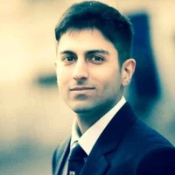
Zenhar Marolia. Synthesis and Questions for Clarification
Location: London, UK
Background: Campion School & Jai Hind (Science) Bombay, India. MEng (Nottingham - Civil Engineering) , MSt IDBE (Cambridge - Interdisciplinary Design for the Built Environment). MBA (Essentials) (London School of Economics)
Position: Property Development – Professional Property Investor, Director Fameh Ltd.
Plan for Future: Return to India as an entrepreneur
Contact
zenharm@googlemail.com
https://www.linkedin.com/in/zenhar-marolia-17746315/
Karishma: Choices to Action
Work with your parents as a team
Create a home where you are
Perfect preparation = proper performance
Nazneen: Adapting to a New Lifestyle
Online technology usage in the US for submissions
Socialize with other cultures
Living with people from other cultures
Vehzan: Leave Home + Social + Cultural
Application based education
Economic decisions are key
Packing things from your home country which you might not get readily in your new environment, for example, spare kusti, pressure cooker, etc.
Opening
Panelists
Commentary
Clarification
Dialog
Closing Remarks
Notes:
In chat box please list your questions for clarification to panelists. Name of panelist and question.
Will open it up to questions via Zoom.

Slide 12
Zenhar Marolia - Let the Dialog Begin – 40 Minutes
Yasna Ha: 30.2: Listen, Reflect, Decide in the context of furthering ushta in Ahura Mazda’s kingdom.
Listen: Seek input from parents, teachers and elders.
Reflect: Upon the options available to you.
Decide: Articulate a choice that is right for you to grow as a Zoroastrian and live a Zoroastrian life.
In this segment our aim is to foster dialog between participants and panelists.
Please use the Reaction button to request to speak OR put up your hand. The moderator will call on you.
Opening
Panelists
Commentary
Clarification
Dialog
Closing Remarks

Slide 13
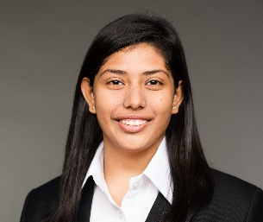
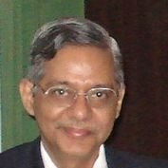
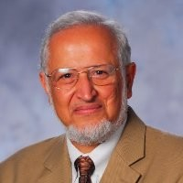
Closing Remarks – 10 Minutes
Karishma Koka
dr.kokakavitakarishma@cantab.net
https://www.linkedin.com/in/koka-kavita-karishma-phd-university-of-cambridge-ba82a6103/?originalSubdomain=uk
Nazneen S. Mistry
nazneen.mistry97@gmail.com
https://www.linkedin.com/in/nazneenmistry/
Vehzan Rustomji
vehzan.rustomji@gmail.com
https://www.linkedin.com/in/vehzan/
To continue the dialog and to provide feedback please visit
Zoroastrianfacultynetwork.org
Yazdi Tantra
yazdi@on-lyne.com
https://www.linkedin.com/in/yazditantra/
Farrokh Mistree
Farrokh.mistree@ou.edu
https://www.linkedin.com/in/farrokh-mistree-8ba8389/
Opening
Panelists
Commentary
Clarification
Dialog
Closing Remarks
Notes:
13
Yazdi – Resource Guide.

