Slide 1

Panelists
Neville S. Shroff-President & Managing Trustee of the Zoroastrian Association, Zoroastrian Charitable Trust of Hong Kong, Canton & Macao.
T. J. Ravishankar-Director J N Tata Endowment for the Higher Education of Indians & Head, Individual Grants Program (Education), Tata Trusts.
Ryan Pereira-Regional Officer, United States-India Educational Foundation (USIEF). Also managing the Fulbright Scholarship Programme.
Farrokh Rustomji-Chief Executive
R D Sethna Scholarship Fund
Entrepreneurship is the pursuit of opportunity beyond resources controlled
In conversation with Zoroastrian students
Scholarships and Funding for Higher Education
Synthesizer
Zenhar Marolia
Moderator
Farrokh Mistree
farrokh.mistree@ou.edu
Notes:
Farrokh R

Slide 2
Forthcoming Conversations
January 17, 2021. 7:30PM India Time. 7:00PM Pakistan Time.
Getting most of College Experience + Building your network + Selling yourself
Panelists - Farzin Avari + Zenhar Marolia + Nazneen Mistry
February 21, 2021. 7:30PM India Time. 7:00PM Pakistan Time.
On being happy as a Zoroastrian graduate student away from home
Panelists - Farzin Avari+ Karishma Koka + Hosherder Polad
Notes:
Farrokh R
Farrokh R to Farrokh M

Slide 3
Plan for Conversation on December 20, 2020
1. What this webinar is all about: 5 Minutes.
2. Panelists Introductions: 2 minutes each. Total 8 minutes.
3. Panelists Talk: 10 minutes each. Total 40 minutes
4. Dialog – Moderated to foster dialog between panelists and participants. Total 30 minutes
5. Closing Remarks: ZFN official + Panelists + Moderator. Total 10 minutes.
Opening
Panelists
Commentary
Clarification
Dialog
Closing Remarks
Notes:
Farrokh M

Slide 4
What We Are About?
The World Zoroastrian Chamber of Commerce (WZCC) in partnership with Zarathushti faculty in academia envision empowering Zarathushti students to learn how to create economic, cultural and intellectual value.
ZFN MISSION: Facilitate Zoroastrian youth, through higher and specialized education, to pursue careers in industry, government, and academia as business entrepreneurs, social entrepreneurs and knowledge entrepreneurs.
ZFN Webinars: Conversations to help Zoroastrain youth with support of their parents to attain higher and specialized education.
This initiative is supported by R. D. Sethna Scholarship Fund. https://www.rdsethnascholarships.org/ For further information contact rdsethnascholarship@gmail.com
Opening
Panelists
Commentary
Clarification
Dialog
Closing Remarks
Notes:
Farrokh M
Farrokh M to Farrokh R

Slide 5
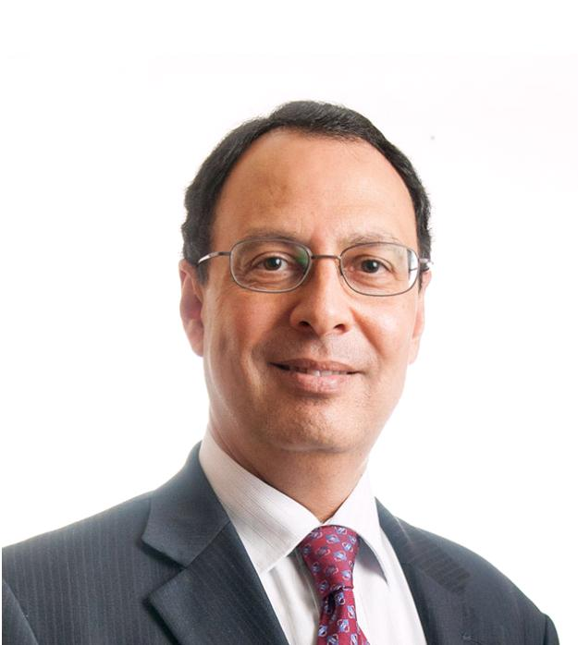
Neville S. Shroff
Position: CEO of Shroff & Company Limited, a Hong Kong based trading and manufacturing company, established in 1950 which provides a range of household products and services to various markets globally.
Education: Secondary education in Hong Kong. Tertiary education in the United Kingdom. MBA from the University of Warwick.
Community service:
President and Managing Trustee of the Zoroastrian Association, Zoroastrian Charitable Trust of Hong Kong, Canton and Macao.
Board of Directors of the prestigious Hong Kong General Chamber of Commerce
Member of the Hong Kong Housing Society & Investment Committee.
Vice Chairman, Royal Commonwealth Society in Hong Kong, a charitable organization whose Patron is Queen Elizabeth II.
Director, Hong Kong Tuberculosis, Chest & Heart Diseases Association.
Governing Board of the Ruttonjee Hospital.
Recognition: “Justice of Peace”by the Hong Kong Government in 2015, in recognition for his business and charitable contributions to the Hong Kong community.
Contact details: Email: nsshroff@shroff.com
Opening
Panelists
Commentary
Clarification
Dialog
Closing Remarks
Notes:
Farrokh R.

Slide 6

  Neville S. Shroff
1. Name of Trust / Funding Agency / Organization:
The Incorporated Trustees of the Zoroastrian Charity Funds of Hong Kong, Canton and Macao
  Goal / vision:
    To support and help Charitable wherever needed.
    Promote the wellbeing of our Zoroastrian community.
  Type of funding:
    Loan
  Amount:
    US$5,000 loan to students in USA
  Number awarded:
    Annually about 80 students globally each year.
  Conditions:
    Must satisfy the criteria as per our Form, which needs to be filled up
2. Timeline for Application
  Usually, 3 months prior to entering University.
3. Documents for Application
  As per our Form, including the University confirmed admission letter with the course to be taken.
  If any other Trusts that have been applied with the amounts if approved.
4. Contact Information
  Mr Neville Shroff at email nshroff@shroff.com.hk
Opening
Panelists
Commentary
Clarification
Dialog
Closing Remarks
Notes:
Neville
Neville to Farrokh M
A complex system is a system composed of interconnected parts that as a whole exhibit one or more properties (behavior among the possible properties) not obvious from the properties of the individual parts.
A system’s complexity may be of one of two forms: disorganized complexity and organized complexity.^{[2]} In essence, disorganized complexity is a matter of a very large number of parts, and organized complexity is a matter of the subject system (quite possibly with only a limited number of parts) exhibiting emergent properties.

Slide 7
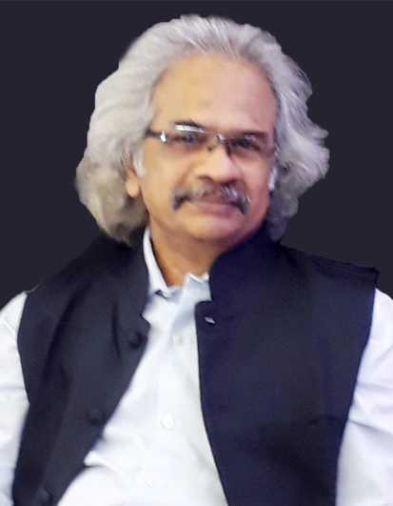
T.J. Ravishankar
Position: Director of The JN Tata Endowment for the Higher Education of Indians and Head, Individual Grants Program (Education), Tata Trusts. Since July 2015.
He manages various domestic and overseas scholarship programs and other initiatives in Tata Trusts
Career: Prior to JN Tata Endowment he was with TCS engaged in research. He spent 16 years in teaching and about 5 years in business journalism with Business India and The Economic Times. He has been a Senior Guest Faculty at the Xavier’s Institute of Communications for several years. He undertook the research and basic writing for a book on Ramnath Goenka, promoter of Indian Express and contributed to the first Indian edition of the UK-based Superbrand. He holds two Masters Degrees – M Com & MA in Philosophy.
Contact information
Tel: 022-66657643
Email: TJRAVISHANKAR@TATATRUSTS.ORG
Website: WWW.JNTATAENDOWMENT.ORG
TATA Trusts
Mulla House, 4th floor
51, Mahatma Gandhi Road, Fort,
Mumbai-400001
Opening
Panelists
Commentary
Clarification
Dialog
Closing Remarks
Notes:
Farrokh R

Slide 8
THE J.N. TATA ENDOWMENT
FOR THE HIGHER EDUCATION OF INDIANS
Founder’s vision
“…There is one kind of charity common enough among us… It is that patchwork philanthropy which clothes the ragged, feeds the poor, and heals the sick. I am far from decrying the noble spirit which seeks to help a poor or suffering fellow being… [However] what advances a nation or a community is not so much to prop up its weakest and most helpless members, but to lift up the best and the most gifted, so as to make them of the greatest service to the country.”
- Jamsetjee Nusserwanjee Tata
Notes:
Ravishankar

Slide 9
LOAN SCHOLARSHIP PROCESS
The J. N. Tata Endowment awards a one-time loan scholarship to Indian nationals for Postgraduate/Ph.D./Postdoctoral/Research fellowships studies abroad, in all fields, irrespective of caste, creed, gender or community.
The amount to be awarded to each scholar by way of the loan scholarship is determined on the basis of the norms laid down for the purpose, and does not cover the full cost of studies. The amount awarded as the loan scholarship ranges between Rs.1,00,000/- and Rs.10,00,000/-.
The selected scholars may also be recommended for a gift scholarship and partial travel assistance from our allied Trusts. A gift scholarship can be for a maximum amount of Rs.7,50,000/- and the travel grant can be a maximum of Rs.50,000/-.
The loan has to be repaid in five equal instalments from the end of the third year or as soon as they start working, whichever is earlier

Slide 10
ELIGIBILITY CRITERIA
Candidates should be Indian nationals who are graduates of a recognised Indian University and have secured at least 60% in their last academic examination. If you do not have an undergraduate degree from a recognized University in India, you are not eligible to apply.
Candidates who are at the beginning of the second year of their overseas studies (Fall 2021 – Spring 2022) are also eligible to apply. This is applicable only if the minimum duration of course is 2 years. J N Tata scholars who have fully repaid their existing loan scholarship account are eligible to apply.
Candidates in the final year of the degree course and those awaiting results are eligible to apply. Candidates may apply even if they do not have the admission/offer letters, at the time of making the application, from the Universities to which they have applied for the academic year 2021-2022. However they must update their applications status with the Endowment once they secure admission.
Candidates not older than 45 years as on 30th June, 2021, with a good academic record and experience in their fields, specialization or training may also apply.
Candidates going abroad for seminars, conferences and undergraduate studies are not eligible for the J. N. Tata Endowment Loan Scholarship.

Slide 11
TIMELINE FOR APPLICATION
1st week of December to 2nd week of March | Release of the advertisement inviting applications – window of 3 months. (Using multiple channels)
2nd week of March to 1st week of April | Scrutiny of the applications
2nd week of April (Sunday) | Online test on the lines of Thinking Skills Assessment to shortlist candidates for interview. (Results are declared within 7 days after the exam)
3rd week of April to 3rd week of June | Interviews over skype or in person with the Director of the Endowment and Subject Experts who are drawn from the industry, professions, reputed Indian Universities, IITs, TIFR. Some are from overseas universities such as University of Rotterdam and Framingham State University, University of Queensland and few former J N Tata Scholars.
1st week of July | Final results are declared based on the principle of relative merit

Slide 12
KEY POINTS
Highly competitive: Not just how good you are but how good you are relative to others.
Get a good GRE/GMAT/TOEF/IELTS score – it matters.
Write a good Statement of Purpose. Don’t burden it with too much biographical information. Focus on explaining the journey (including any deviation) from earlier studies to the choice you are making. Biography may be an influence, but the emphasis is on the intellectual. Write what you can defend. Don’t write to impress.
The first shortlist depends on your academic and related scores – takes you to the online test - TSA
Thinking Skills assessment – a great deal of material is freely available. Takes you to the interview.
Interview is rigorous – take it very seriously. Subject experts are drawn from leading institutions. You must know your subject very well – what you have studied so far and what you have chosen to study. Awareness of what is involved in the chosen study is a great advantage
Notes:
Application – SOP. Interview.

Slide 13
The J N Tata Endowment for the Higher Education of Indians
Mulla House, Fourth Floor
51 Mahatma Gandhi Road, Fort
Mumbai 400 001, India
Telephone +91 22 66657774, 66657198, 66657681
Email jnte@tatatrusts.org
Web www.jntataendowment.org
Opening
Panelists
Commentary
Clarification
Dialog
Closing Remarks
Notes:
Ravishankar to hand back to Farrokh R
A complex system is a system composed of interconnected parts that as a whole exhibit one or more properties (behavior among the possible properties) not obvious from the properties of the individual parts.
A system’s complexity may be of one of two forms: disorganized complexity and organized complexity.^{[2]} In essence, disorganized complexity is a matter of a very large number of parts, and organized complexity is a matter of the subject system (quite possibly with only a limited number of parts) exhibiting emergent properties.

Slide 14
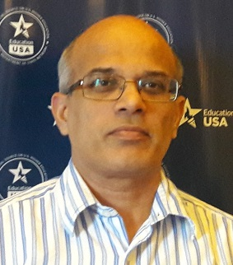
Ryan Pereira
Position: Regional Officer at the United States – India Educational Foundation where he supervises both the Education USA and Fulbright programs in Western India.
Career: Ryan has over nine years’ experience guiding students interested in pursuing higher studies in the U.S. Prior to that, Mr. Pereira taught various courses in Molecular Biology and Biotechnology at St. Xavier’s College Mumbai during the 2009-2010 academic year. Mr. Pereira was a postdoctoral fellow and research associate in the Department of Molecular Medicine at Cornell University where he trained with Dr. Richard Cerione. Originally from Mumbai, he has a B.Sc. in zoology and biochemistry from St. Xavier’s College Mumbai, an M.Sc. in biochemistry from Mumbai University and a Ph.D. in Biochemistry from The Ohio State University.
Contact information
Regional Officer, United States-India Educational Foundation (USIEF)
Maker Bhavan 1, 2nd Floor, Churchgate (E), Mumbai 400020
Tel. +91-22-22624603, 9867761669 * Fax +91-22-22663956 * www.usief.org.in ryan@usief.org.in
Opening
Panelists
Commentary
Clarification
Dialog
Closing Remarks
Notes:
Farrokh R

Slide 15

Fulbright-Nehru and other Fulbright Fellowship Opportunities in the U.S.
Opening
Panelists
Commentary
Clarification
Dialog
Closing Remarks
Notes:
A complex system is a system composed of interconnected parts that as a whole exhibit one or more properties (behavior among the possible properties) not obvious from the properties of the individual parts.
A system’s complexity may be of one of two forms: disorganized complexity and organized complexity.^{[2]} In essence, disorganized complexity is a matter of a very large number of parts, and organized complexity is a matter of the subject system (quite possibly with only a limited number of parts) exhibiting emergent properties.

Slide 16
Application Deadline
Fulbright-Nehru Master’s Fellowships
May 15, 2021
Grant duration : Up to 2 years ($80 K funding cap inclusive of all expenses)
Fields
Arts and Culture Management
Economics
Higher Education Administration
International Legal Studies
Environmental Science/Studies
International Affairs
Urban and Regional Planning
Public Health
Public Administration
Women’s Studies/Gender Studies
Opening
Panelists
Commentary
Clarification
Dialog
Closing Remarks
Notes:
A complex system is a system composed of interconnected parts that as a whole exhibit one or more properties (behavior among the possible properties) not obvious from the properties of the individual parts.
A system’s complexity may be of one of two forms: disorganized complexity and organized complexity.^{[2]} In essence, disorganized complexity is a matter of a very large number of parts, and organized complexity is a matter of the subject system (quite possibly with only a limited number of parts) exhibiting emergent properties.

Slide 17


Fulbright-Nehru Doctoral
Research Fellowships
15
Duration
6-9 months
July, 2021
Designed for scholars registered for a Ph.D. at an Indian institution on or before
September 1, 2020
Application Deadline
Opening
Panelists
Commentary
Clarification
Dialog
Closing Remarks
Notes:
A complex system is a system composed of interconnected parts that as a whole exhibit one or more properties (behavior among the possible properties) not obvious from the properties of the individual parts.
A system’s complexity may be of one of two forms: disorganized complexity and organized complexity.^{[2]} In essence, disorganized complexity is a matter of a very large number of parts, and organized complexity is a matter of the subject system (quite possibly with only a limited number of parts) exhibiting emergent properties.

Slide 18
2021-2022 Fields of Study
Agricultural Sciences
Anthropology
Bioengineering
Climate Change Sciences
Computer Science (including, but not limited to, cyber security, digital economy, quantum computing, artificial intelligence, machine learning and big data analytics)
Economics
Education Policy and Planning
Energy Studies
History
International Law
International Security and Strategic Studies
Materials Science (with emphasis on environmental applications)
Mathematical Sciences
Neurosciences
Performing Arts
Physical Sciences
Public Health
Public Policy
Sociology
Urban and Regional Planning (with emphasis on smart cities and waste management)
Visual Arts
Women’s and Gender Studies
Opening
Panelists
Commentary
Clarification
Dialog
Closing Remarks
Notes:
A complex system is a system composed of interconnected parts that as a whole exhibit one or more properties (behavior among the possible properties) not obvious from the properties of the individual parts.
A system’s complexity may be of one of two forms: disorganized complexity and organized complexity.^{[2]} In essence, disorganized complexity is a matter of a very large number of parts, and organized complexity is a matter of the subject system (quite possibly with only a limited number of parts) exhibiting emergent properties.

Slide 19
Recommended applications forwarded to partner agencies in the U.S. for placement
(Oct– Dec)
Program Announcement
in January
Application screening by subject experts
(June - August)
National interviews
of short-listed candidates
(August – November)
Issuance of grant terms
(May – January)
Application Deadline
(mid-May to mid- September)
J1 Visa requires you to leave the US and return to your country
Fulbright Timeline
and Review Process
J-1 visa processing
(July onwards)
Scholars depart to the U.S. (July onwards)
Opening
Panelists
Commentary
Clarification
Dialog
Closing Remarks
Notes:
A complex system is a system composed of interconnected parts that as a whole exhibit one or more properties (behavior among the possible properties) not obvious from the properties of the individual parts.
A system’s complexity may be of one of two forms: disorganized complexity and organized complexity.^{[2]} In essence, disorganized complexity is a matter of a very large number of parts, and organized complexity is a matter of the subject system (quite possibly with only a limited number of parts) exhibiting emergent properties.

Slide 20
Academic credentials and professional ability
Merit of the proposed Fulbright project
Need to conduct research in the U.S.
Outcomes, potential impact and benefits
Motivation, seriousness of purpose, maturity,
leadership, cultural adaptability
Ability to contribute as a cultural
ambassador beyond the specified field of study
Communication skills
Commitment to community and national service
SELECTION CRITERIA
Opening
Panelists
Commentary
Clarification
Dialog
Closing Remarks
Notes:
A complex system is a system composed of interconnected parts that as a whole exhibit one or more properties (behavior among the possible properties) not obvious from the properties of the individual parts.
A system’s complexity may be of one of two forms: disorganized complexity and organized complexity.^{[2]} In essence, disorganized complexity is a matter of a very large number of parts, and organized complexity is a matter of the subject system (quite possibly with only a limited number of parts) exhibiting emergent properties.

Slide 21
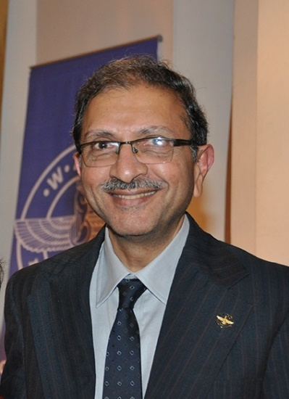
Farrokh M. Rustomji
Position: Chief Executive Officer at R. D. Sethna Scholarship Fund in India. Farrokh has over 17 years of experience in dealing with Higher Education and scholarship matters. In collaboration with ZFN, R. D. Sethna Scholarship Fund assists students in providing information and funding by way of loan scholarships to Indian students for higher studies in India and abroad.
Education: Graduated from the Loyola College, Chennai.
Community service:
Founder Director of the World Zarathushti Chamber of Commerce in India
Core Team Member of the Zoroastrian Faculty Network (ZFN).
Contact information
Tel: 022 - 22077044
Email: rdsethnascholarship@gmail.com
Website: www.rdsethnascholarships.org
R. D. Sethna Scholarship Fund
Esplanade House
29, Hazarimal Somani Marg, Fort
Mumbai – 400 001
Notes:
Farrokh R

Slide 22
  Farrokh M. Rustomji
1. Name of Trust / Funding Agency / Organization
  Goal / vision: Promote and encourage Scientific, Technical, Industrial and Commercial instruction or education in ways beneficial to society and nation.
  Type of funding
  Loan scholarships are granted to citizens of India only for higher education in India and abroad.
  Amount is decided based on the information submitted in the Form.
  Number awarded: Annually about 300 students.
  Conditions
  Indian citizens living in India.
  University / College should be recognized by the Local Government.
  https://www.rdsethnascholarships.org/eligibility-criteria/
2. Timeline for Application
  Rolling decisions.
  Applications must be submitted prior to joining the University.
3. Documents for Application
  As per details in the application form.
  https://www.rdsethnascholarships.org/application-form/
4. Contact Information
  R. D. Sethna Scholarship Fund
  Esplanade House
  29, Hazarimal Somani Marg, Fort,
  Mumbai – 400 001
  Tel: 022 – 22077044
  Email: rdsethnascholarship@gmail.com
  Web Address: www.rdsethnascholarships.org
Opening
Panelists
Commentary
Clarification
Dialog
Closing Remarks
Notes:
Farrokh R. Hand off to Zenhar.
A complex system is a system composed of interconnected parts that as a whole exhibit one or more properties (behavior among the possible properties) not obvious from the properties of the individual parts.
A system’s complexity may be of one of two forms: disorganized complexity and organized complexity.^{[2]} In essence, disorganized complexity is a matter of a very large number of parts, and organized complexity is a matter of the subject system (quite possibly with only a limited number of parts) exhibiting emergent properties.

Slide 23

  Zenhar Marolia - Synthesis and Questions for Clarification
Location: London, UK
Background: Campion School & Jai Hind (Science) Bombay, India. MEng (Nottingham - Civil Engineering) , MSt IDBE (Cambridge - Interdisciplinary Design for the Built Environment). MBA (Essentials) (London School of Economics)
Position: Property Development – Professional Property Investor, Director Fameh Ltd.
Plan for Future: Return to India as an entrepreneur
Contact
zenharm@googlemail.com
https://www.linkedin.com/in/zenhar-marolia-17746315/
Key Points
Pay attention to the vision of those who set up these scholarship programs.
If you take a loan then it must be repaid to help the trusts to help more people in in the future.
Ensure that you respond to the prompts in the application. Respond by taking the listed selection criteria into account.
Pay careful attention to what is to be included in a Statement of Purpose.
Your choice (based on your passion) needs to be supported by sound reasoning and good timely preparation..
Be prepared to articulate why you have chosen to get this this degree, how it will set you up not just for your first job but jobs to follow in years to come.
Hosherdar Polad as backup
Opening
Panelists
Commentary
Clarification
Dialog
Closing Remarks
Notes:
In chat box please list your questions for clarification to panelists. Name of panelist and question.
Will open it up to questions via Zoom.
Vehzan to Farrokh M

Slide 24
  Farrokh Mistree - Let the Dialog Begin – 40 Minutes
Yasna Ha: 30.2: Listen, Reflect, Decide in the context of furthering ushta in Ahura Mazda’s kingdom.
Listen: Seek input from parents, teachers and panelists.
Reflect: Upon the options available to you.
Decide: Articulate a choice that is right for you to grow as a Zoroastrian and live a Zoroastrian life.
In this segment our aim is to foster dialog between participants and panelists.
Please use the Reaction button to request to speak OR put up your hand. The moderator will call on you.
Opening
Panelists
Commentary
Clarification
Dialog
Closing Remarks
Notes:
Farrokh M
Karishma – Keep track of chat

Slide 25

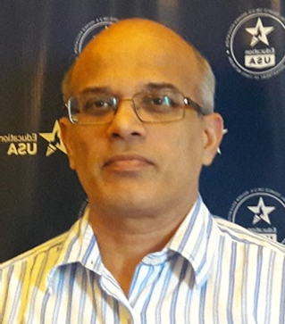
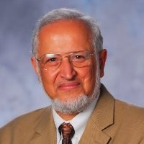

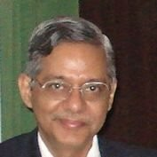
Closing Remarks – 10 Minutes
Neville S. Shroff
nshroff@shroff.com.hk
https://www.esf.edu.hk/neville-shroff/
http://www.shroff.com.hk/
T.J. Ravishankar
tjravishankar@tatatrusts.org
https://www.jntataendowment.org/
Ryan Pereira
ryan@usief.org.in
http://www.usief.org.in/
Farrokh Mistree
Farrokh.mistree@ou.edu
https://www.linkedin.com/in/farrokh-mistree-8ba8389/
Farrokh M. Rustomji
rdsethnascholarship@gmail.com
www.rdsethnascholarships.org
To continue the dialog and to provide feedback please visit
Zoroastrianfacultynetwork.org
Yazdi Tantra
yazdi@on-lyne.com
https://www.linkedin.com/in/yazditantra/
Opening
Panelists
Commentary
Clarification
Dialog
Closing Remarks
Notes:
25
Farrokh M to invite each person
Fix Neville email. nshroff@shroff.com.hk

Slide 26
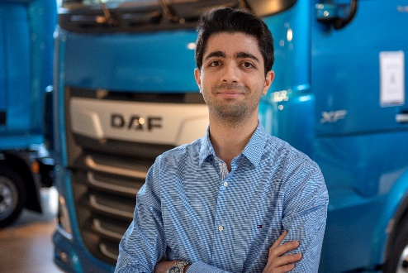
Vehzan Rustomji - Synthesis and Questions for Clarification
Location: Eindhoven, Netherlands
Background: Born in New Delhi, brought up in Mumbai. B.Tech. in Mechatronics at Manipal Institute of Technology, India. M.Sc. in Automotive Technology at TU Eindhoven, Netherlands.
Position: System Calibration Engineer (Engine Development) at DAF Trucks.
Passion: To enable the next generation to take better decisions.
Contact
vehzan.rustomji@gmail.com
https://www.linkedin.com/in/vehzan/
Key Points
Pay attention to the vision of those who set up these scholarship programs.
If you take a loan then it must be repaid to help the trusts to help more people in in the future.
Ensure that you respond to the prompts in the application. Respond by taking the listed selection criteria into account.
Pay careful attention to what is to be included in a Statement of Purpose.
It is important to know what you wish to study and know why you wish to pursue this degree.
Be prepared to articulate why you have chosen to get this this degree, how it will set you up not just for your first job but jobs to follow in years to come.
Opening
Panelists
Commentary
Clarification
Dialog
Closing Remarks

